Slide 1


MS OFFICE COURSE
EXCEL

Slide 2





EXPLAIN
Before the class
Take
notes
Practice !
Watch
video
You need to watch
the video and read the documents assigned on
Google classroom
Take notes on computer about those video and readings
The only way to process is to practice a lot

Slide 3
EXPLAIN
Course evaluation
CHAPTER | EVALUATION | RATIO %
Word | Homework | 10
 | Project | 30
Power Point | Homework | 10
 | Project | 10
Excel | Homework | 10
 | Project | 30

Slide 4
Excel for zero to hero !
Cells
References
Filler Handle
Formatting
Filter
Sort
Conditional formatting
Formulas
Multiple sheets
Graphs
PROJECT

Slide 5

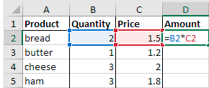
OBJECTIVES FOR TODAY
Understand and use cell references
Compute sums with cell references and formulas
Here D2 use 2 cell references : B2 and C2

Slide 6


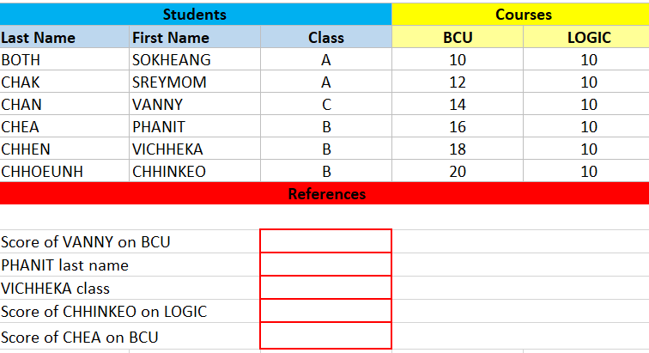
PRACTICE
Activity 1 – References
Complete the red cells using cell references
After 15 min, discuss about you solution in group of 4
15 MIN
Notes:
TRAINER :
Give a very brief introduction of all mentioned features

Slide 7
REVIEW
Activity 1 – What is a dynamic reference?
Let’s change VANNY score on BCU…
We change this
This cell also changes!
References are dynamic : when the value change, the reference also changes
Notes:
TRAINER :
Give a very brief introduction of all mentioned features

Slide 8
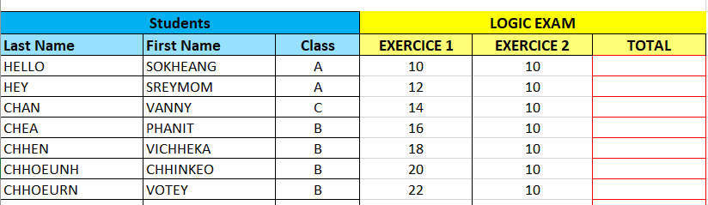
PRACTICE
Activity 2 – Sum of references
15 MIN
Write on each red cell the student total score (EXERCICE 1 + EXERCICE 2)
You need only 2 actions to do it :)
After 15 min, discuss about you solution in group of 4
Notes:
TRAINER :
Give a very brief introduction of all mentioned features

Slide 9
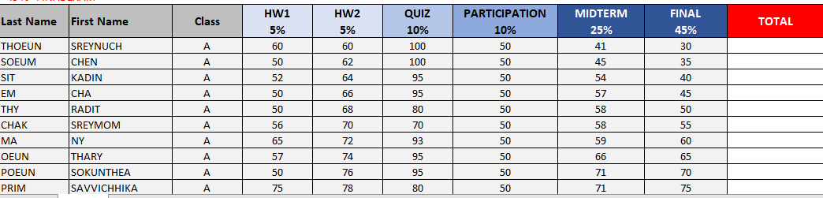
PRACTICE
Activity 3 – Other operations
Compute the TOTAL grade of the LOGIC course for all students
- 05 % HOMEWORK 1
- 05% HOMEWORK 2
- 10 % QUIZ
- 10 % PARTICIPATION
- 25 % MIDTERM EXAM
- 45 % FINAL EXAM
15 MIN
Notes:
TRAINER :
Give a very brief introduction of all mentioned features

Slide 10
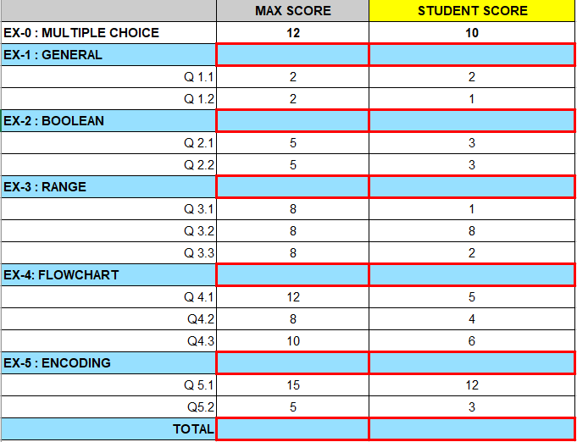
PRACTICE
Activity 4 - Exam score sheet
15 MIN
Create the grade system for logic exam
Ex1 is sum of Q1.1 and Q1.2
Ex2 is sum of Q2.1 and Q2.2
Ex3 is sum of Q3.11, Q3.2 and Q3.3
Ex4 is sum of Q4.1, Q4.2 and Q4.3
Ex5 is sum of Q5.1 and Q5.2
The total is the of all exercises results (from 0 to 5).
Your grading system should also give the student's total grade as in the following image
Notes:
TRAINER :
Give a very brief introduction of all mentioned features

Slide 11

Self
evaluation
Evaluate yourself on the objectives of this session
Complete the sheet provided by your teacher

Slide 12

WARNING
You need to watch those videos before next class
FILL HANDLE
https://www.youtube.com/watch?v=RC9puYz4tic
FORMAT TEXT
https://www.youtube.com/watch?v=fjyOG7Ls7BA

Slide 13

WANT MORE ?
Explore other videos provided by GCFGlobal.org
https://edu.gcfglobal.org/en/excel
Create your own excel file to try !

